Slide 1
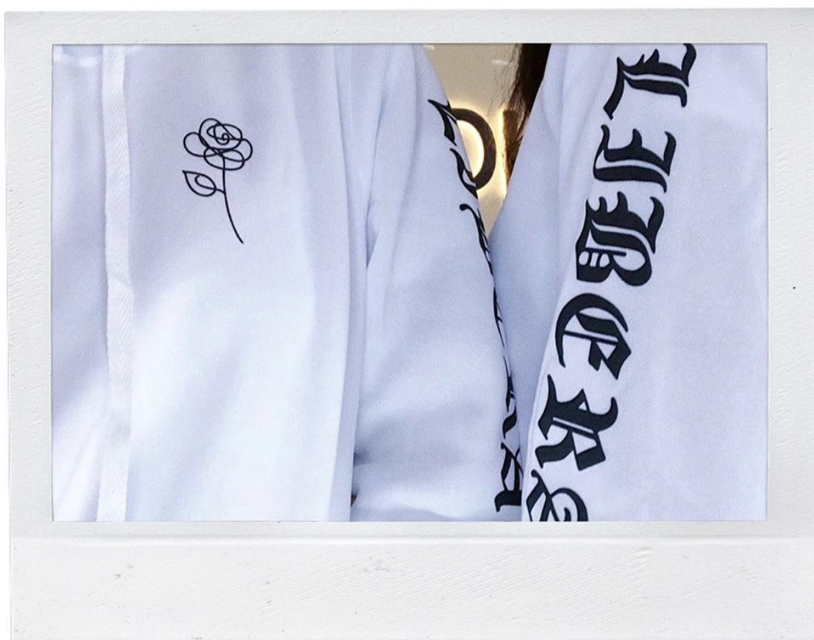
CUSTO!;
By shikin, fatin, aarthi, jeannete, gaya, jerry

Slide 2

Target Customers
Our company are looking for customers that loves to design their own clothings/ideas and we are providing them services to fulfil their wishes and helped them produce the clothing that they desire.

Slide 3

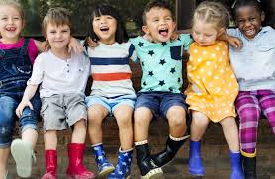

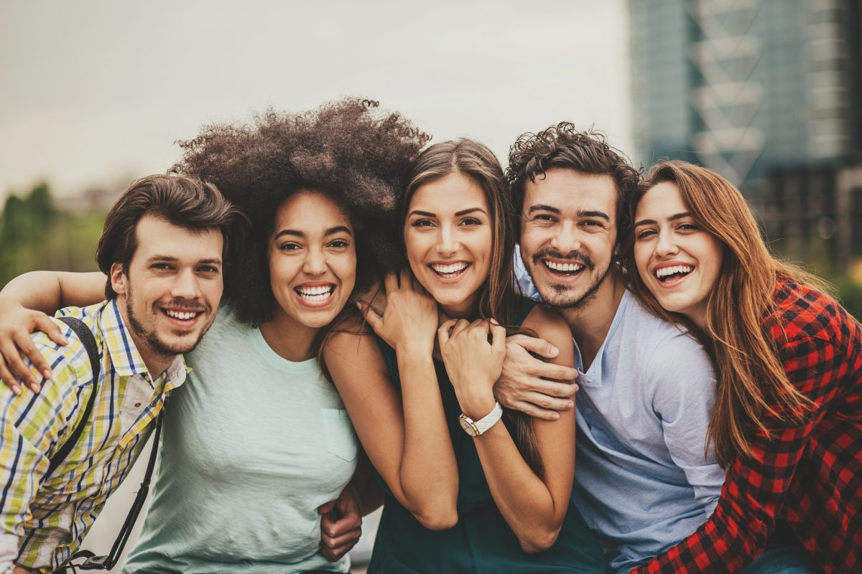
Target Customer
Our target is kids, teenagers, young adults and adults.
The characteristics of our customers:
People who are willing to explore new fashion by
Creating/designing their own desired shirts.

Slide 4
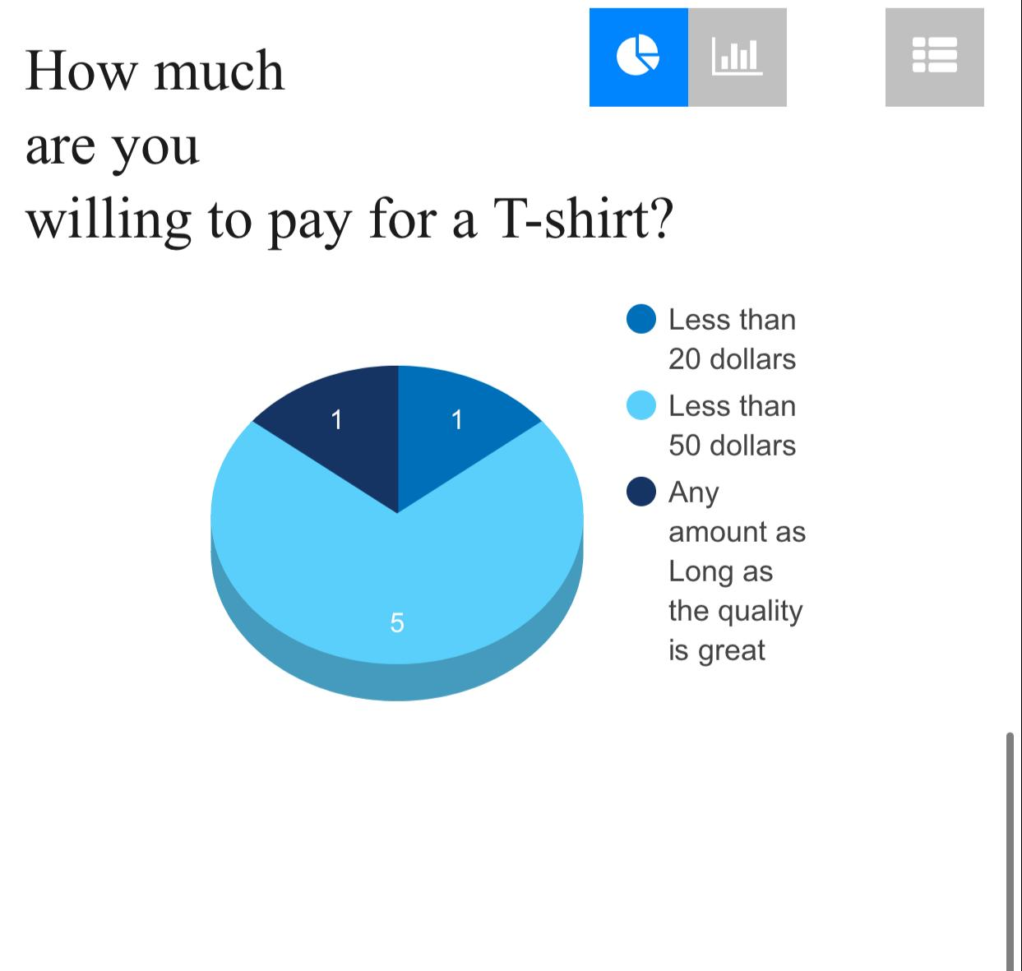
Evidence
Customers are willing to pay for the t-shirt less than $20 the material used to make is quite cheaper but still wearable. Higher the price for the better quality shirts such as Linen, Nylon , Polyester etc.

Slide 5
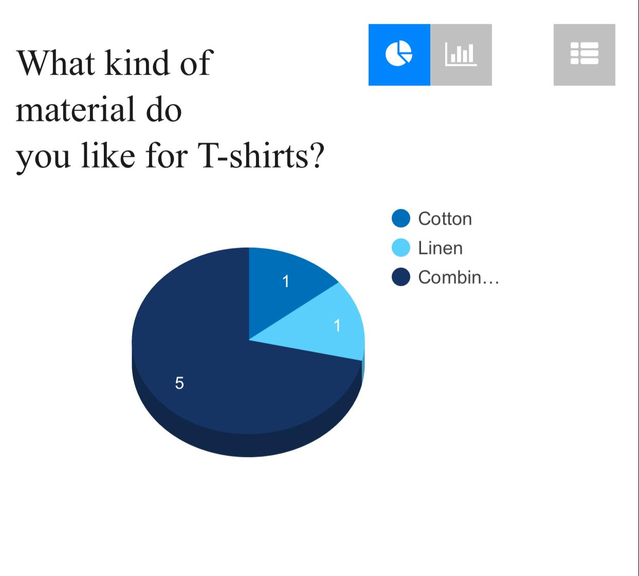
Evidence
We did a feedback form for the customer about what type of materials they mostly choose/what they are usually comfortable with.

Slide 6
Evidence
Linen:
Customers purchase linen clothes because linen fibres absorb sweat and moisture offering pleasant and comfortable wear.
Cotton:
Customers purchase cotton clothes becauseit is so comfortable to wear, many prefer cotton fabrics when it comes to underwear and undershirts.
Combination:
Customers purchase combination clothes because combining two or more fabrics allows the best qualities to emerge making the best T-shirts that feel great and last forever. it has organically grown cotton and natural dyes. It is environment friendly.

Slide 7
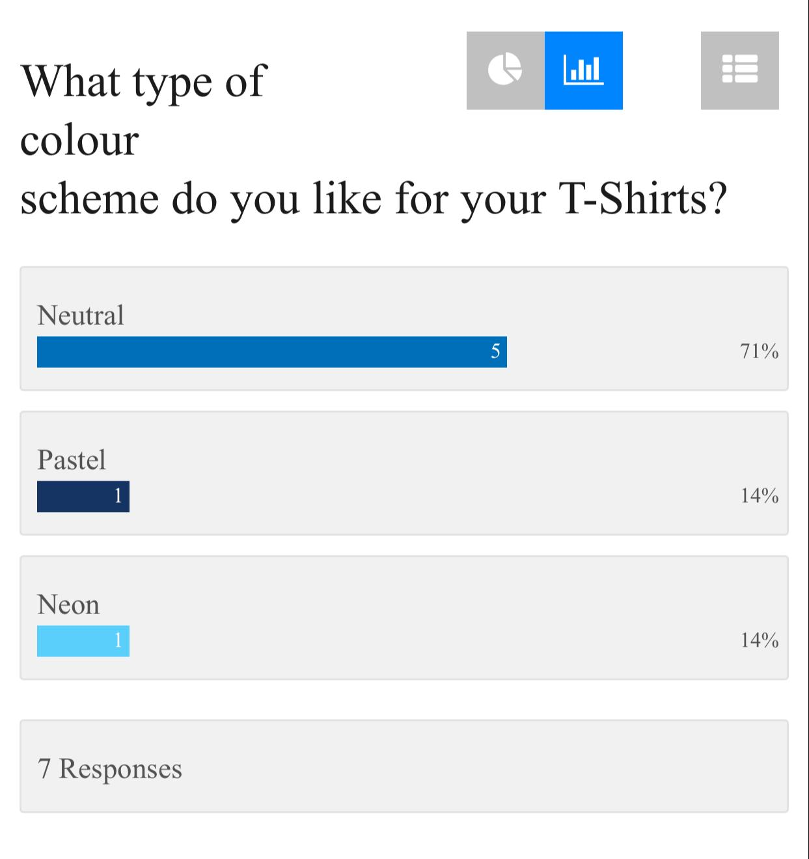
Evidence
we did the feedback form on what type of colour scheme does customers like. The colors that we gave on option was neutral ,pastel and neon The customers mostly like neutral colour as it is easier to match colors with other clothes.

Slide 8

Video

Slide 9
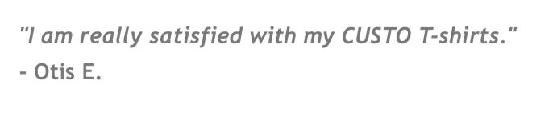
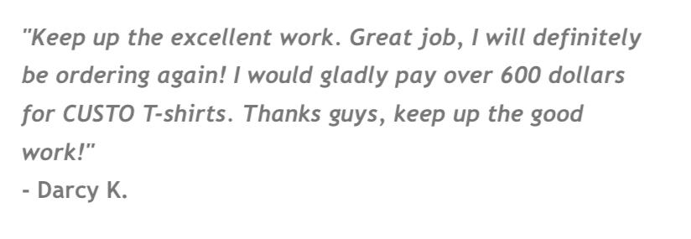
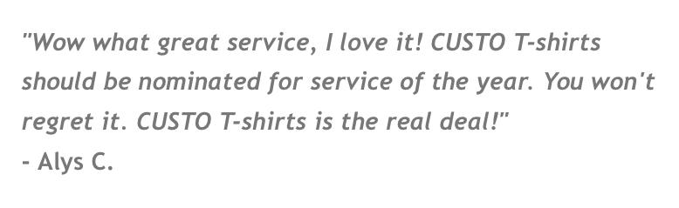
Evidence
This is the feedback we get from customers that bought our clothes!

Slide 10
Thank You, May God Bless You Everyday ☺
-by custo; team

